Slide 1
GROUP NAME: SETTS
Project Title: Quizzly App

Slide 2
Group Members Matric Numbers and Names
BHU/23/04/08/0001 Obafaye Tolulope Benita (CYBER SECURITY)
BHU/23/04/10/0006 Shaneil Alabegbe Esohe (INFORMATION TECHNOLOGY)
BHU/23/04/09/0074 Stephanie Bitram Boyi (CYBER SECURITY)
BHU/23/01/07/0044 Esther Peculiar Elias (COMPUTER SCIENCE)
BHU/23/04/09/0041 Timileyin Adeola Tobe (CYBER SECURITY)

Slide 3
PROJECT DESCRIPTION
Quiz App is a dynamic and engaging mobile application designed to provide users with an enjoyable and educational quiz experience. The app offers a wide range of quiz categories, interactive features, and a user-friendly interface to ensure a fun and informative experience for all ages. Whether users are looking to test their knowledge, learn new facts, or challenge friends, Quiz Master has something for everyone
Project Structure
The project consists of the following files and directories:
index.html: The main entry point of the application, responsible for rendering the home page.
quiz.html: The page where users can take quizzes.
results.html: The page where users can view their quiz results.
dashboard.html: The page where administrators can manage quizzes and users.
styles.css: The stylesheet for the application, responsible for layout and design.
script.js: The JavaScript file responsible for handling user interactions and updating the UI.
data.json: A JSON file containing quiz questions and answers.

Slide 4
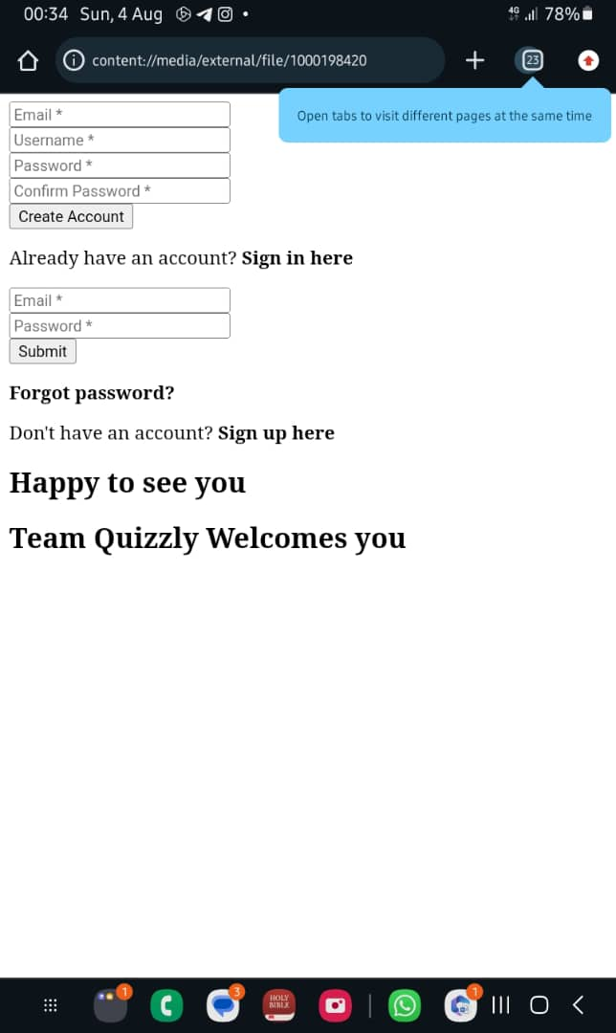
Obafaye Tolulope Benita BHU/23/04/09/0001

Slide 5
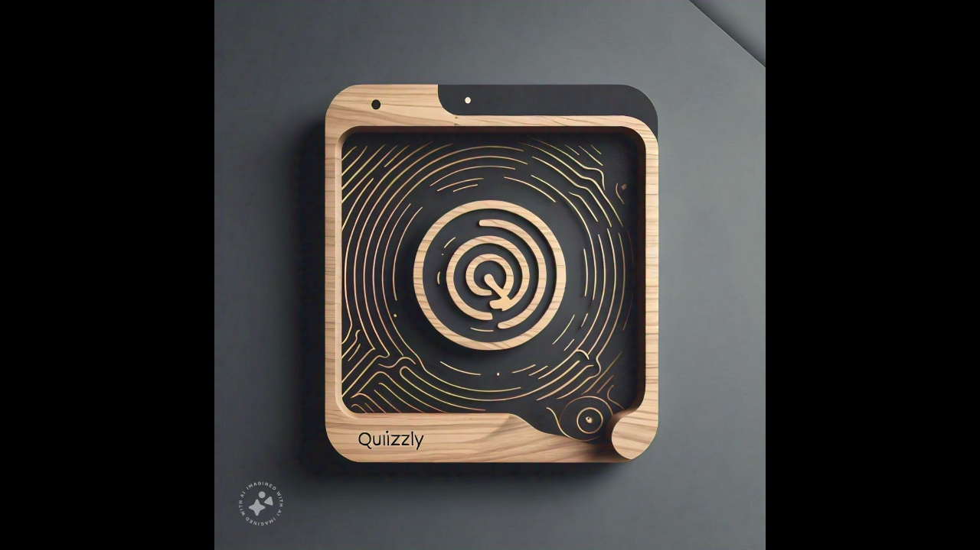
Stephanie Bitram Boyi BHU/23/04/09/0074

Slide 6
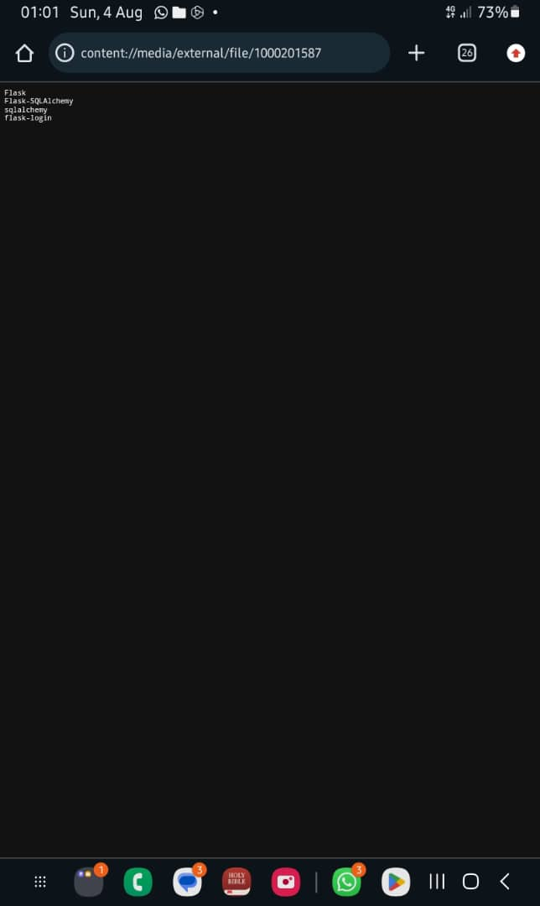
Esther Peculiar Elias BHU/23/01/07/0044

Slide 7
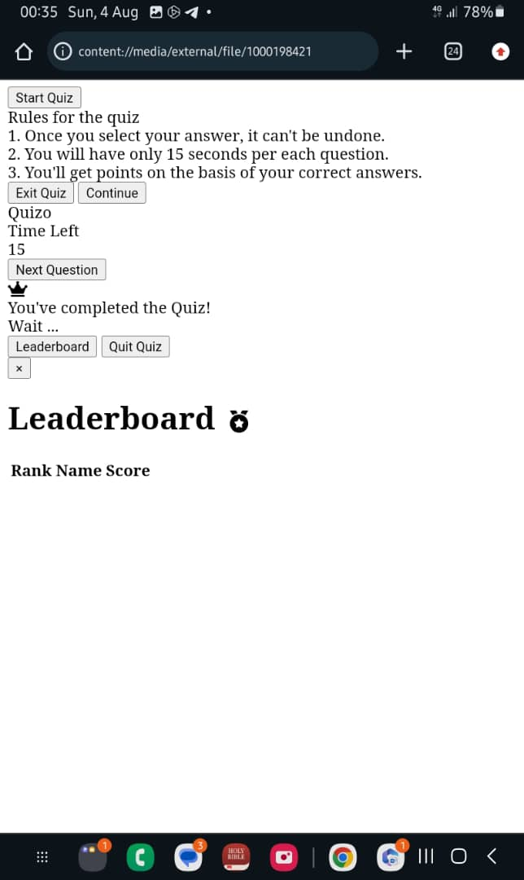
Shaneil Alabegbe Esohe BHU/23/04/10/0006

Slide 8
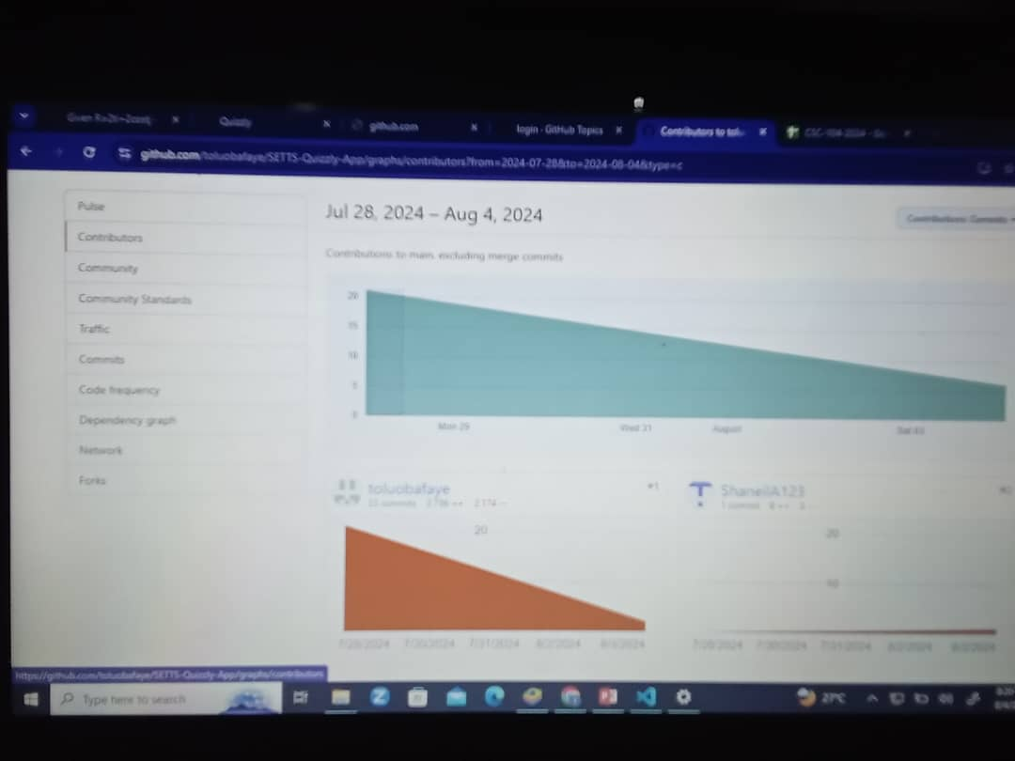
The Github Contribution Page

